Slide 1
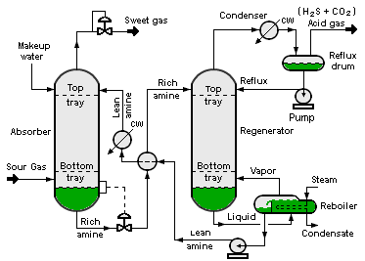

Slide 2
Zoom Shape 1
Zoom Shape 2
Zoom Shape 3

Slide 3
